Slide 1
SIMULATION OF FACULTY ADVISORY SYSTEM AND AUTOMATION OF ATTENDANCE AND REGISTRATION
BY
A. SAI KARTHIK
ARPAN KUNDU
RAKHEE POONAM LAKRA
SAAHIL KAMAT

Slide 2
INTRODUCTION
Faculty Advisory System is basically updating the manual process of registration into an internet based application so that a faculty member can directly register a student, of whom (s)he is a faculty advisor, for a course in case the student has no library or hostel dues.
The project is specifically designed for the use of hostel staff, library staff, faculty members and students. The product will work as a complete user interface for registration process.

Slide 3
RELATIONAL DATABASE MODEL
users
id | name | email | password | contact | city | address | type | FA | hostel_dues | room
semester
sem | status
library_rec
id | title | author | quantity
instrutor
cid | fid

Slide 4
enroll
sid | cid | sem | T1 | T2 | assignment | end_sem | total | grade
course
id | name
check_out
sid | bid | due_date
attendance
sid | cid | date | session | status

Slide 5
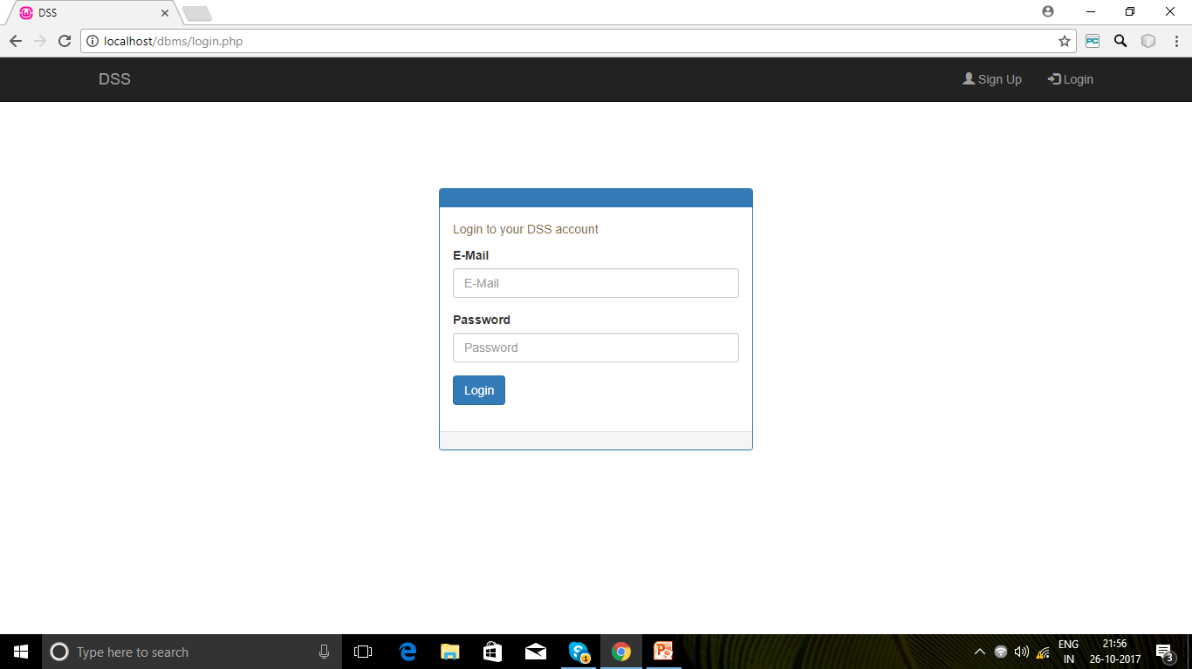
LOGIN PAGE
Allows a user to login by entering his/her login credentials.
Will login a user iff the e-mail id and the password entered are correct.

Slide 6
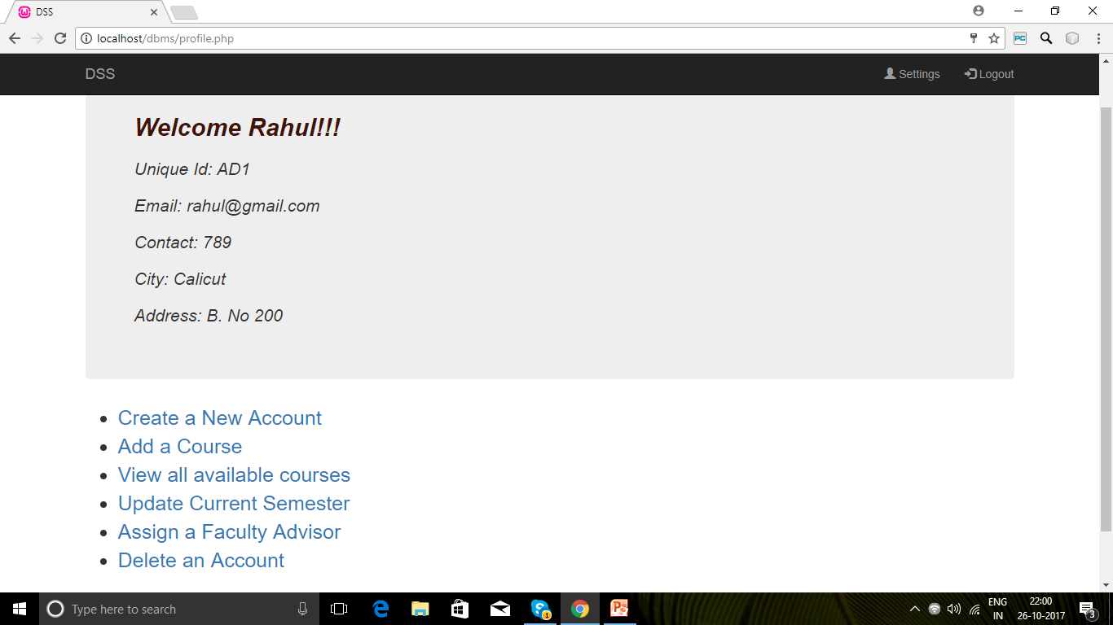
ADMIN PAGE
Displays a menu of tasks which can be executed by an admin.

Slide 7
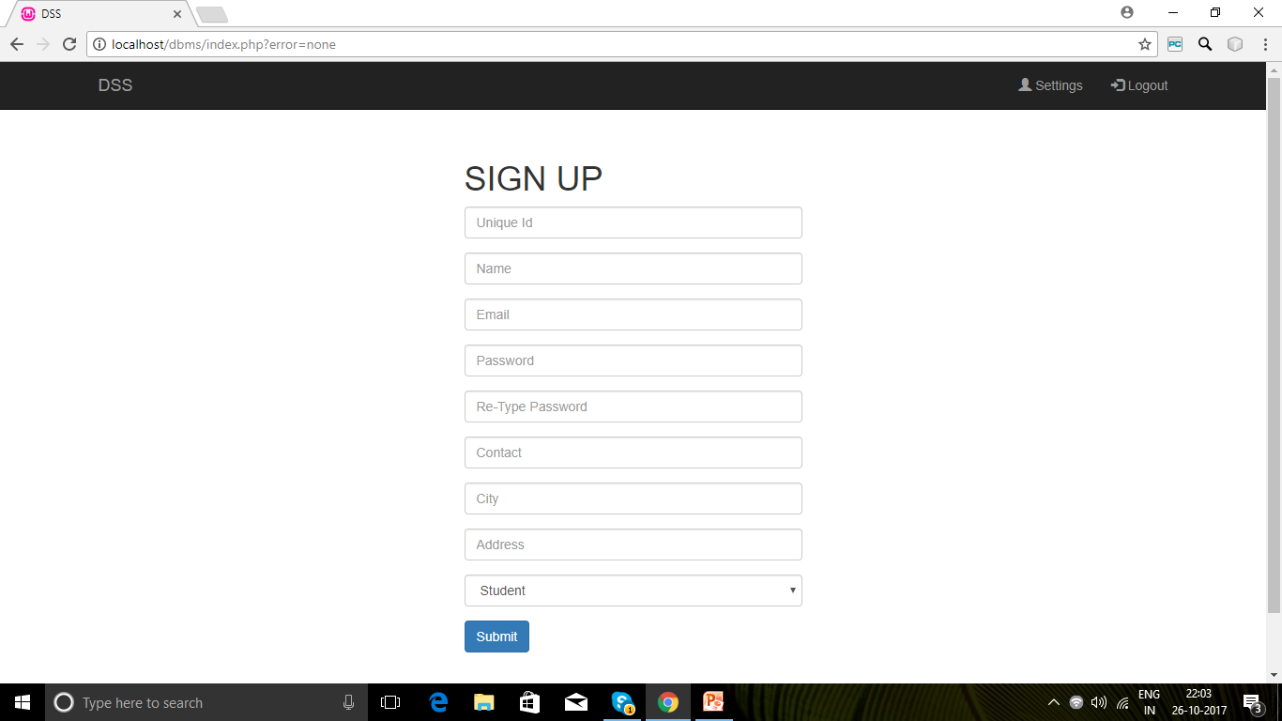
CREATE A NEW ACCOUNT
Allows an admin to create the account of a new user.
A new tuple is added to users table.

Slide 8
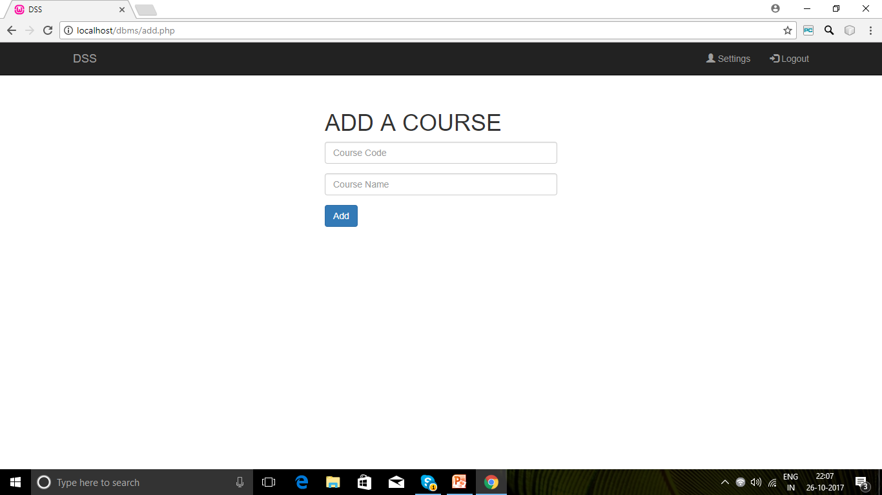
ADD A COURSE
Allows an admin to add a new course.
A new tuple is added to course table.

Slide 9
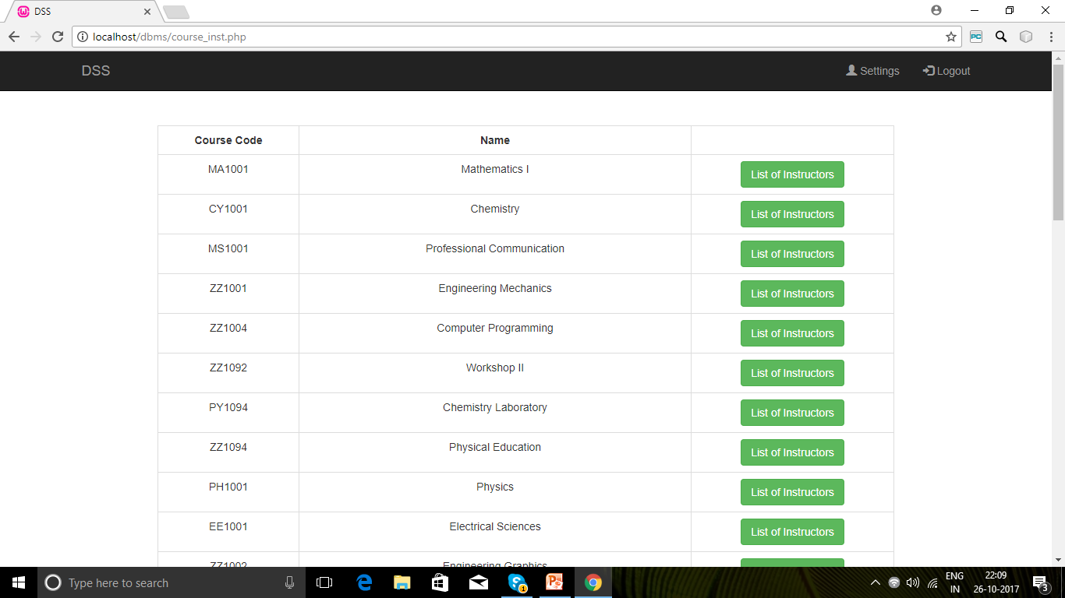
VIEW ALL AVAILABLE COURSES
Allows an admin to view all available courses.
Records are retrieved from course table.

Slide 10
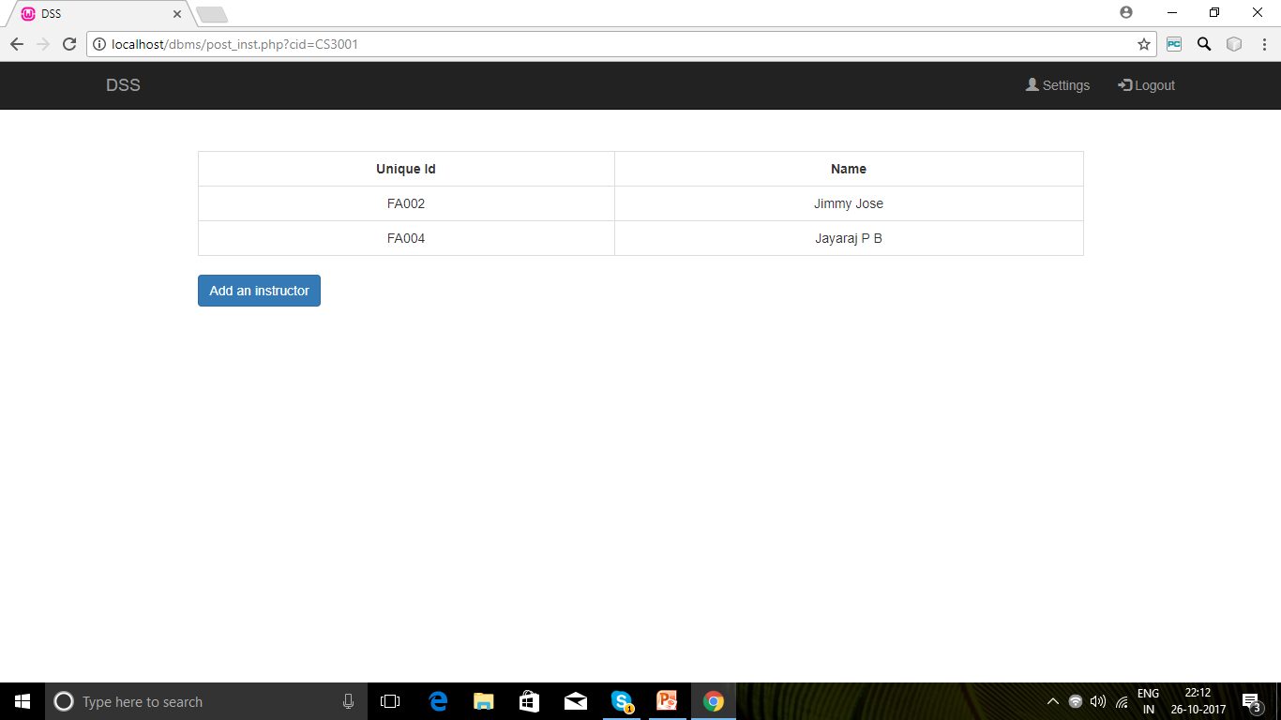
LIST OF INSTRUCTORS
Allows an admin to view all instructors for a particular course.
Records are retrieved from instructor table.
An admin can also assign a new instructor for a particular course.
A new tuple will be added to instructor table.

Slide 11
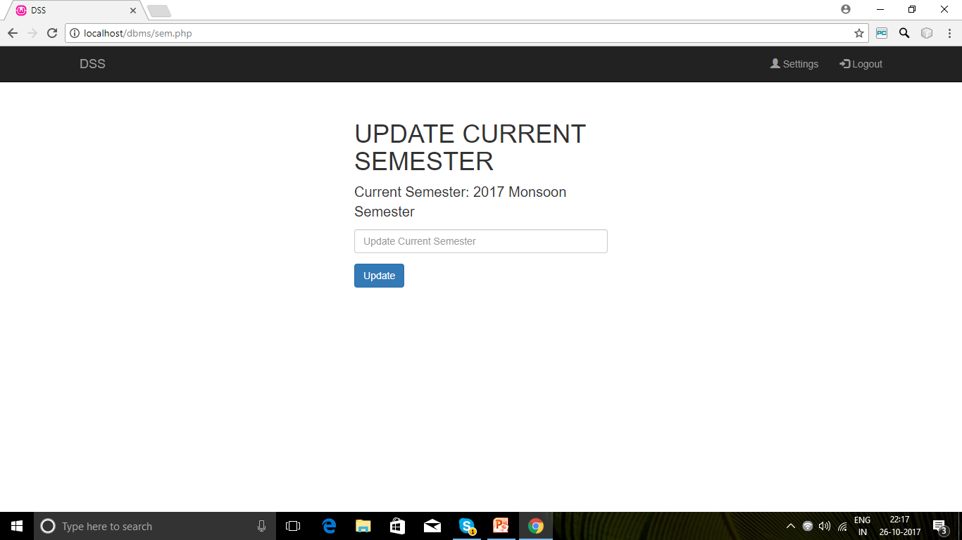
UPDATE CURRENT SEMESTER
Allows an admin to update the current semester.
The tuple in semester table will be updated.

Slide 12
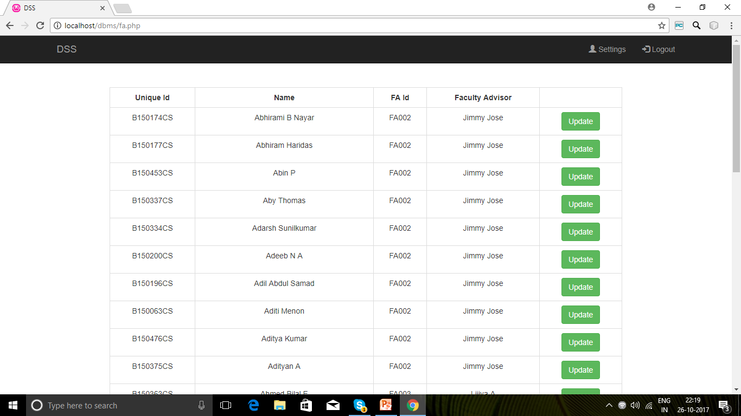
ASSIGN A FACULTY ADVISOR
Allows an admin to view the faculty advisors of all students.
Records are retrieved from users table.
An admin can also assign a new advisor for a particular student.
The FA attribute of the tuple corresponding to that particular student in the users table will be updated.

Slide 13
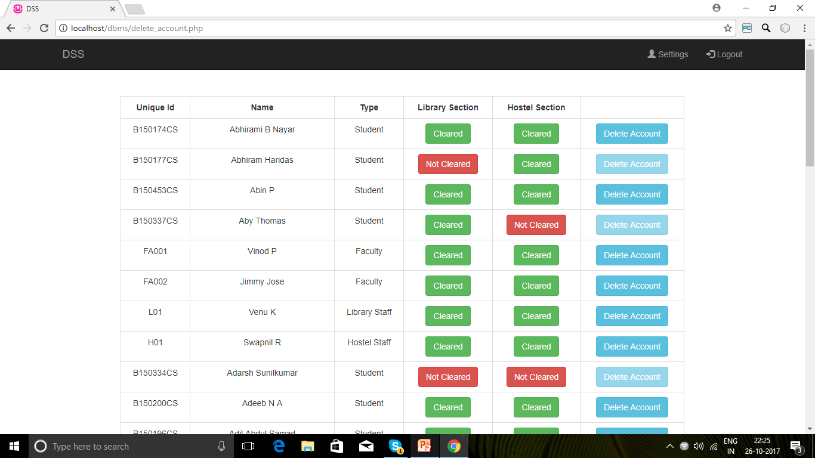
DELETE AN ACCOUNT
Allows an admin to delete the account of a user.
A tuple will be deleted from the users table.

Slide 14
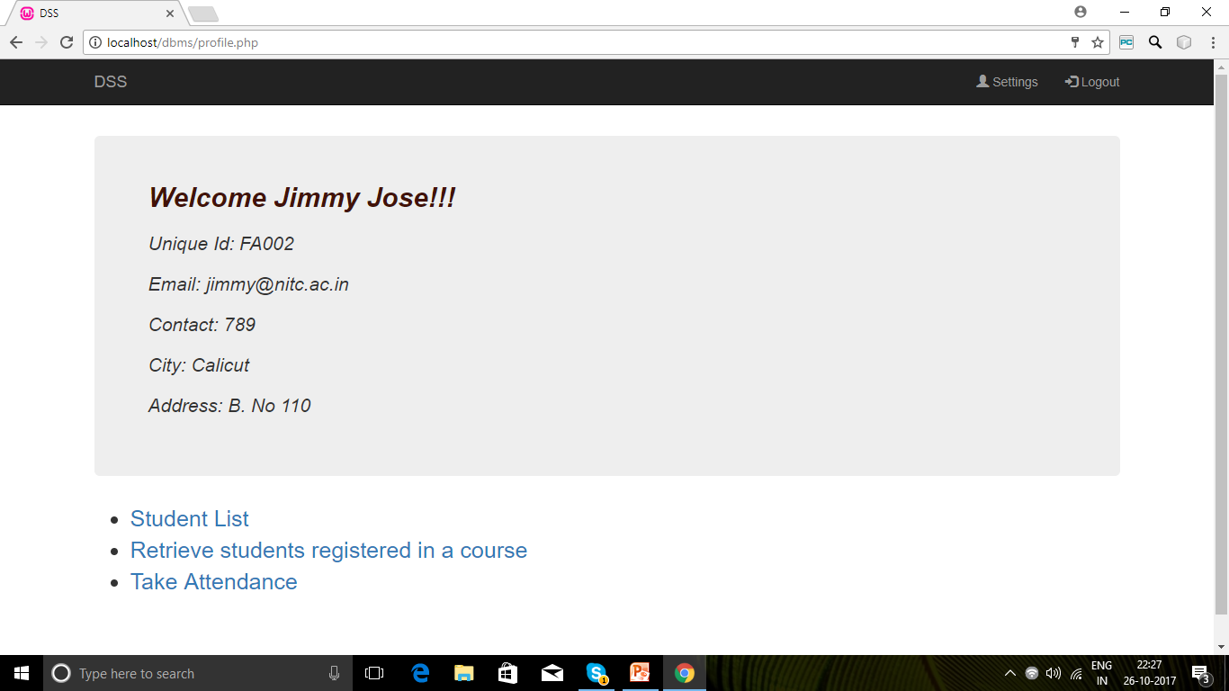
FACULTY PAGE
Displays a menu of tasks which can be executed by a faculty member.

Slide 15
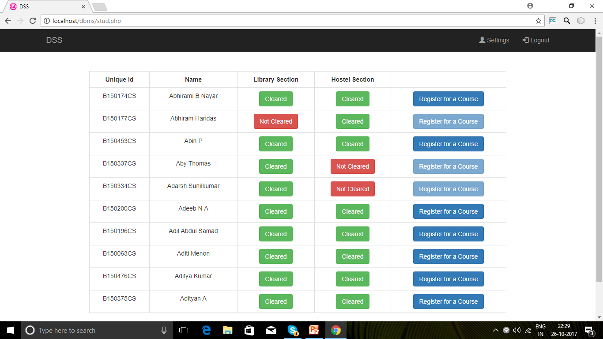
STUDENT LIST
Allows a faculty member to view the list of students whom (s)he is advising.
Records are retrieved from users table.
A faculty advisor can also register a student for various courses iff the student has no hostel or library dues.
A new tuple will be added to enroll table.

Slide 16
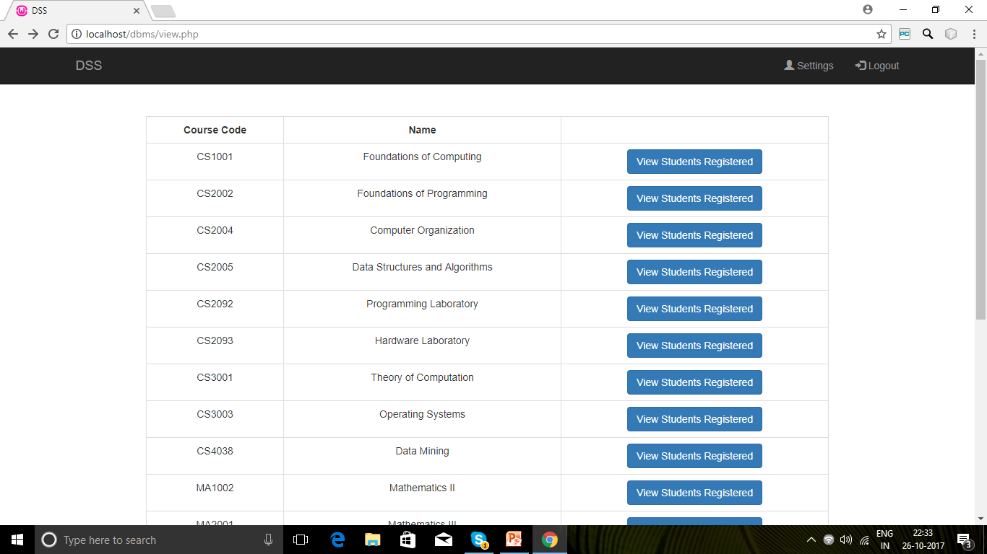
VIEW STUDENTS REGISTERED IN A COURSE
Allows a faculty member to view the list of courses instructed by him/her.
Records are retrieved from instructor table and course table.

Slide 17
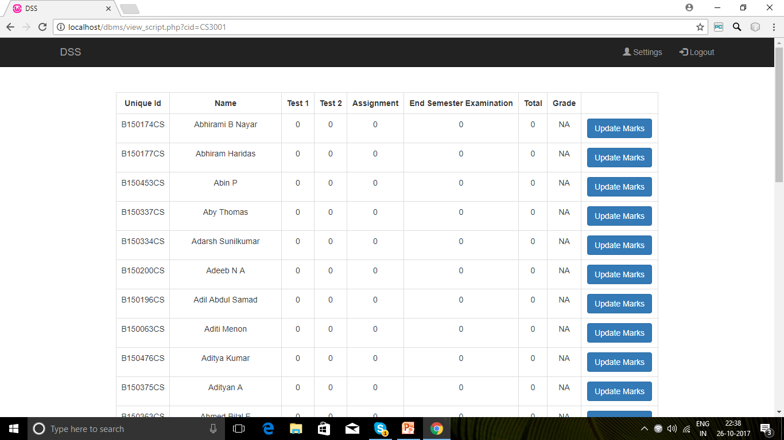
VIEW STUDENTS REGISTERED
Allows a faculty member to view the list of students registered for a particular course instructed by him/her.
Records are retrieved from enroll table and users table.
An instructor can also update the marks of a student and the same will be reflected in enroll table.

Slide 18
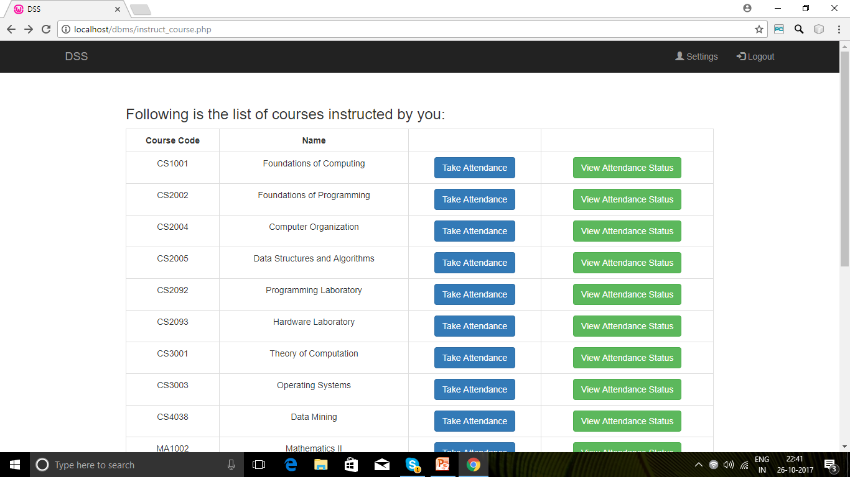
TAKE ATTENDANCE
Allows a faculty member to take attendance for a course instructed by him/her.
A new tuple will be added to attendance table.

Slide 19
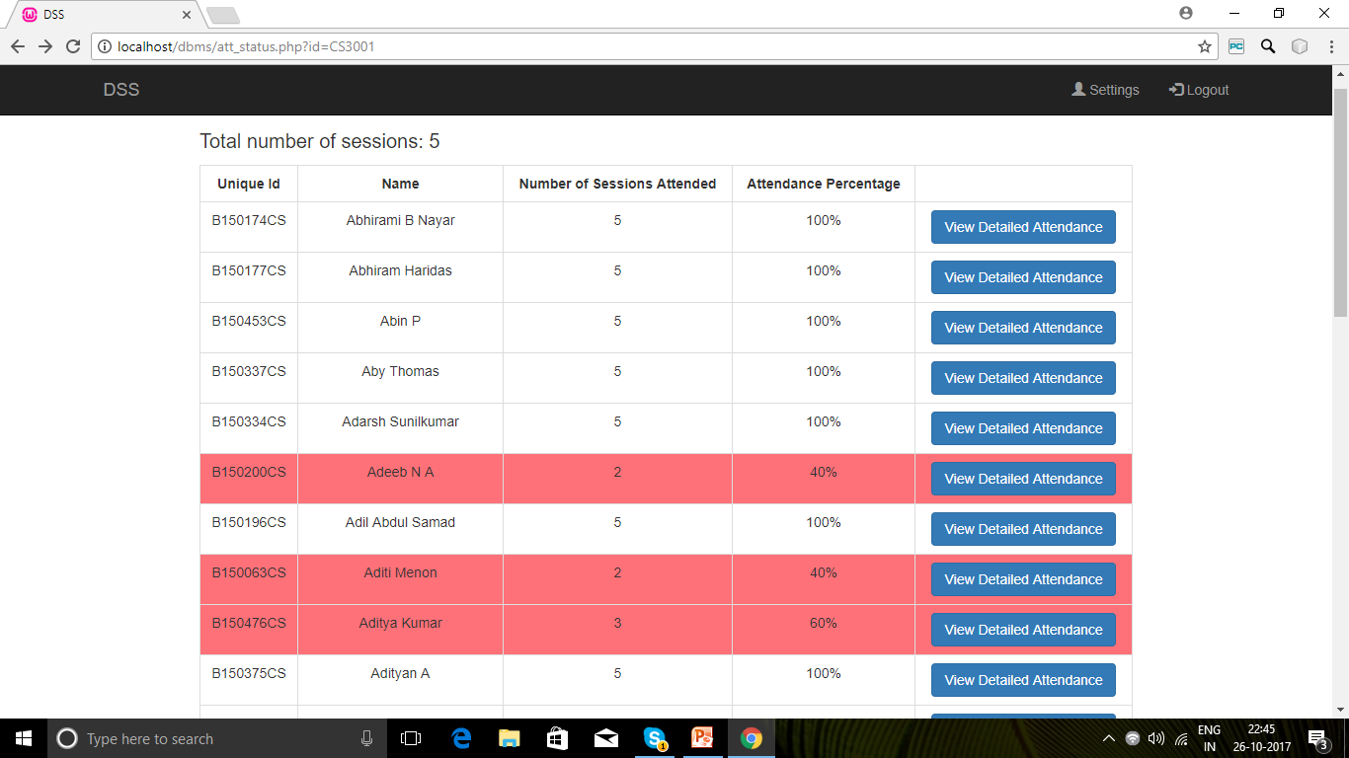
VIEW ATTENDANCE STATUS
Allows a faculty member to view the attendance status of all students registered for a particular course.
Records are retrieved from attendance table and users table.

Slide 20
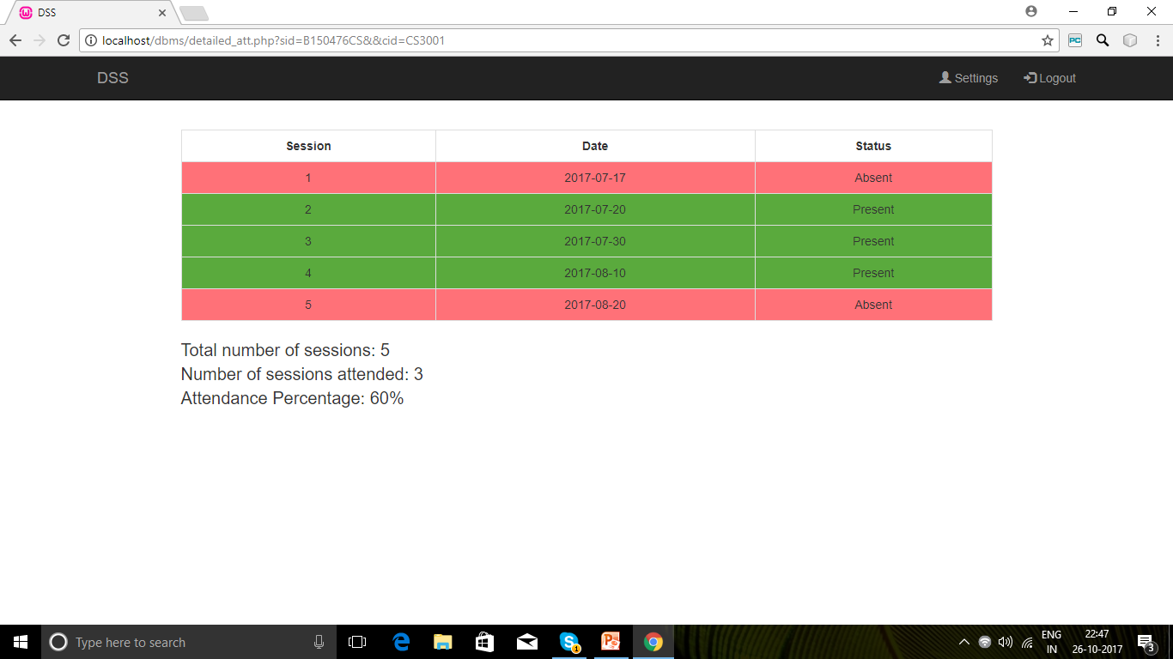
VIEW DETAILED ATTENDANCE
Allows a faculty member to view the detailed attendance status of a student registered for a particular course.
Records are retrieved from attendance table and users table.

Slide 21
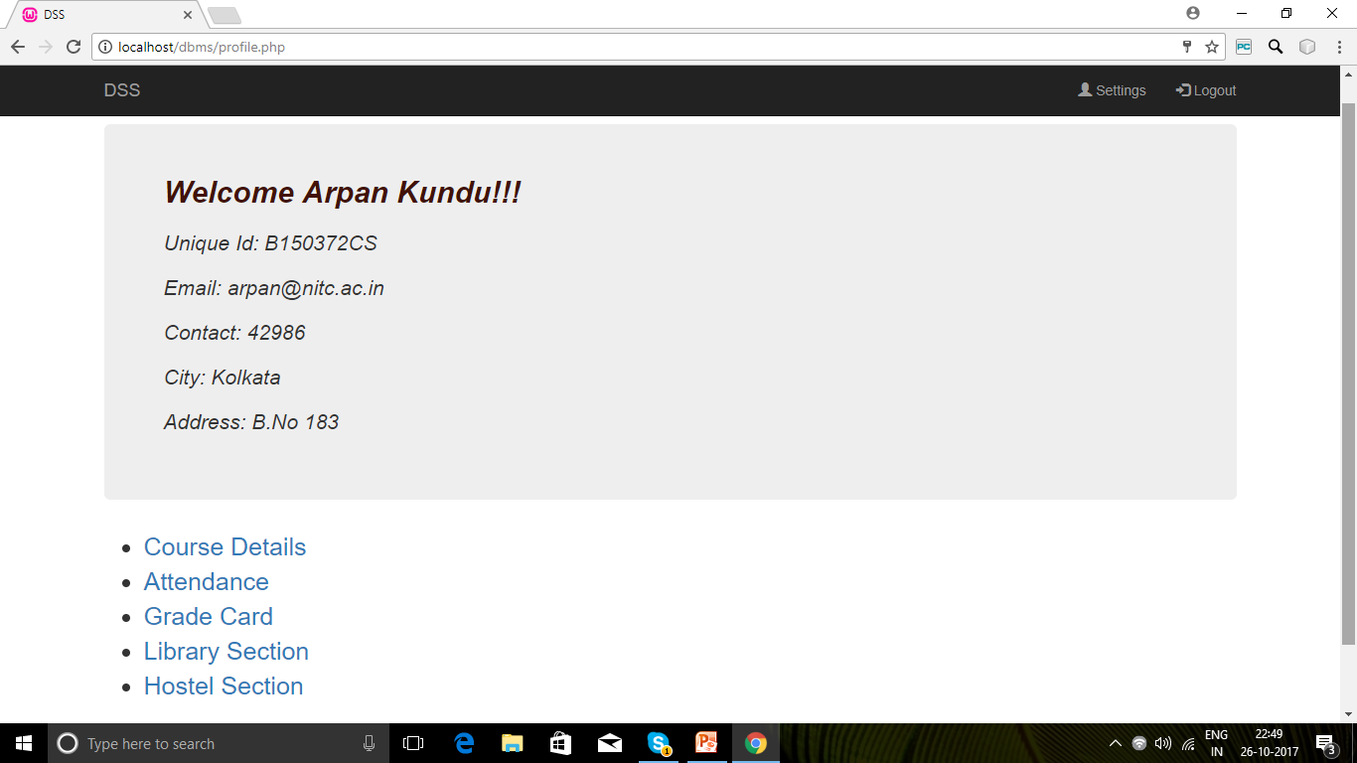
STUDENT PAGE
Displays a menu of tasks which can be executed by a student.

Slide 22
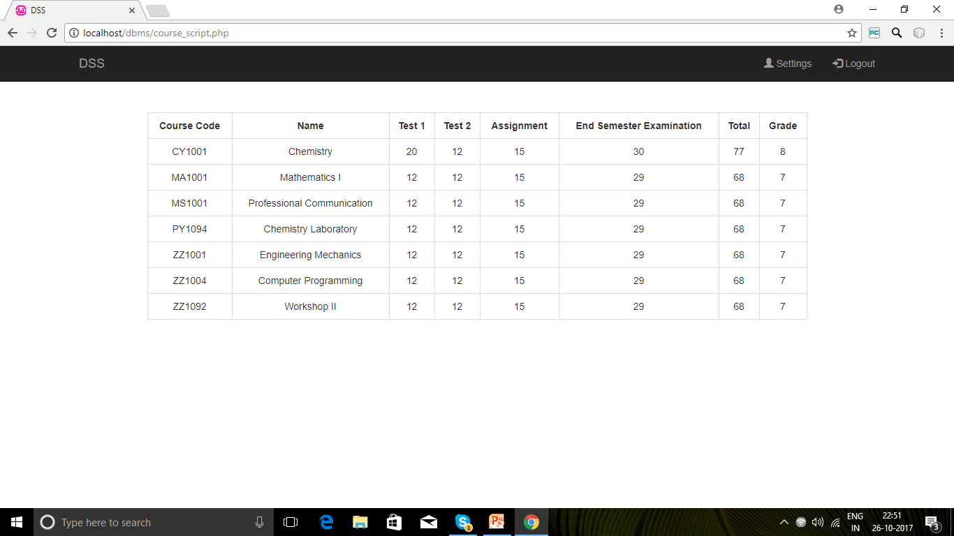
COURSE DETAILS
Allows a student to view the details of the courses for which (s)he was registered in a particular semester.
Records are retrieved from enroll table and course table.

Slide 23
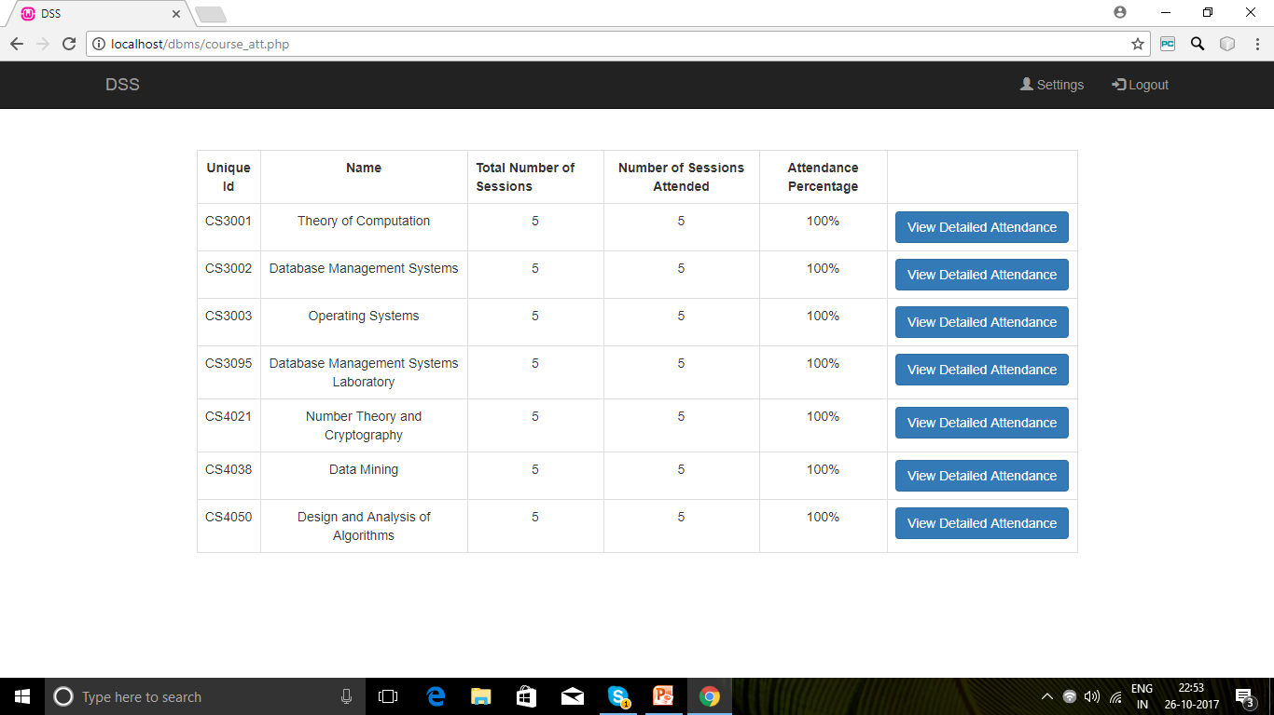
ATTENDANCE
Allows a student to view his/her attendance details for various courses.
Records are retrieved from attendance table and course table.

Slide 24
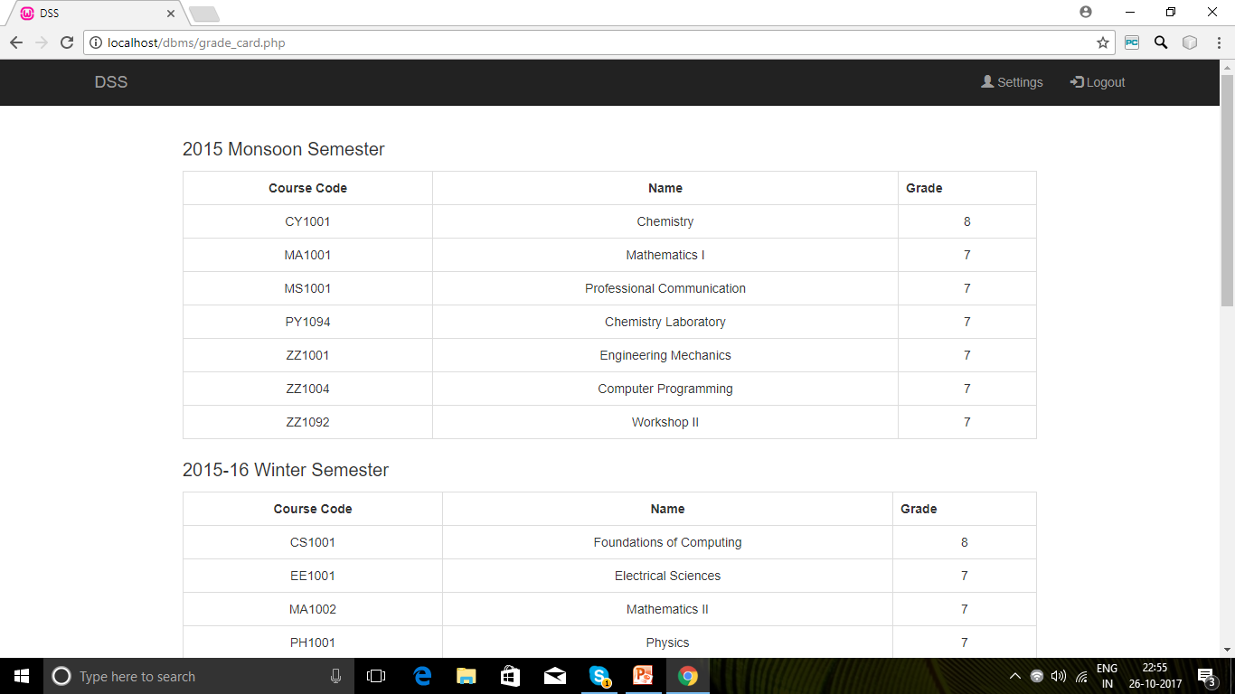
GRADE CARD
Allows a student to view his/her grade card.
Records are retrieved from enroll table and course table.

Slide 25
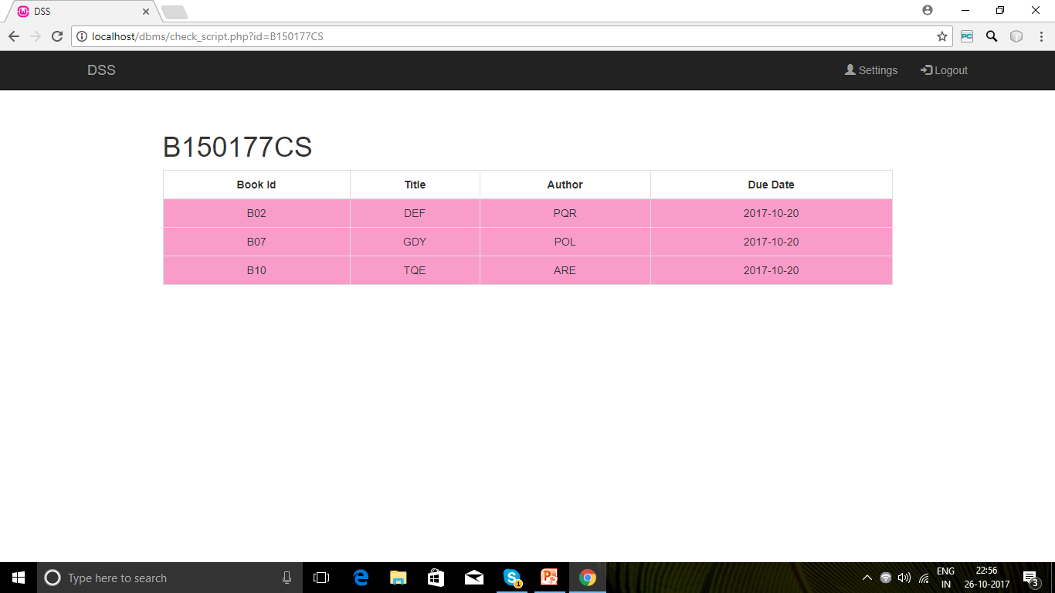
LIBRARY SECTION
Allows a student to view the books checked out by him/her.
Records are retrieved from check_out table and library_rec table.

Slide 26
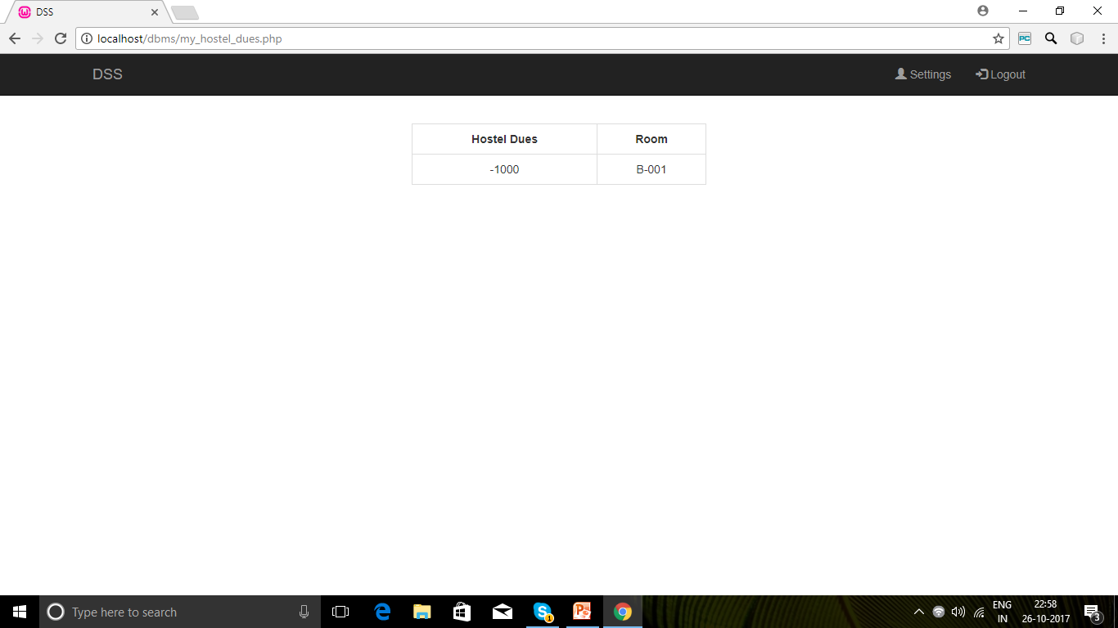
HOSTEL SECTION
Allows a student to view his/her hostel dues and room allotted.
Records are retrieved from users table.

Slide 27
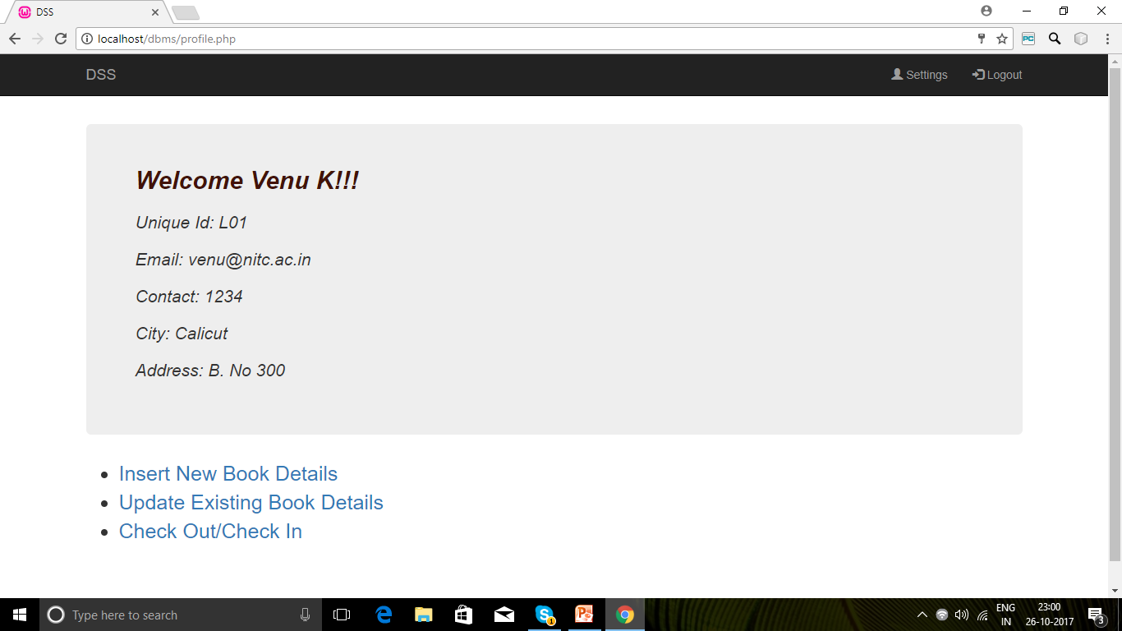
LIBRARY STAFF PAGE
Displays a menu of tasks which can be executed by a library staff.

Slide 28
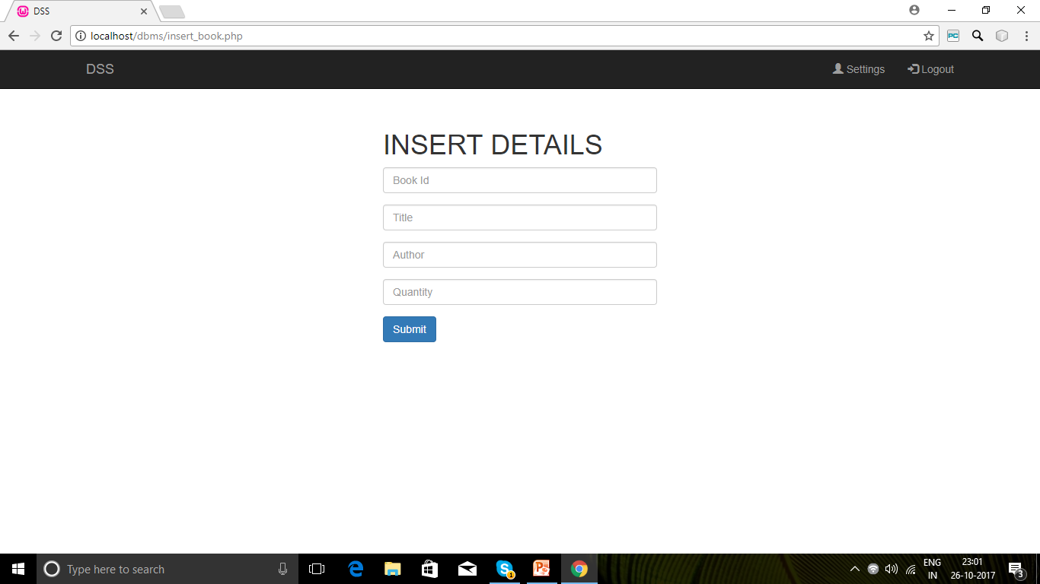
INSERT NEW BOOK DETAILS
Allows a library staff to enter the details of a new book.
A new tuple is added to library_rec table.

Slide 29
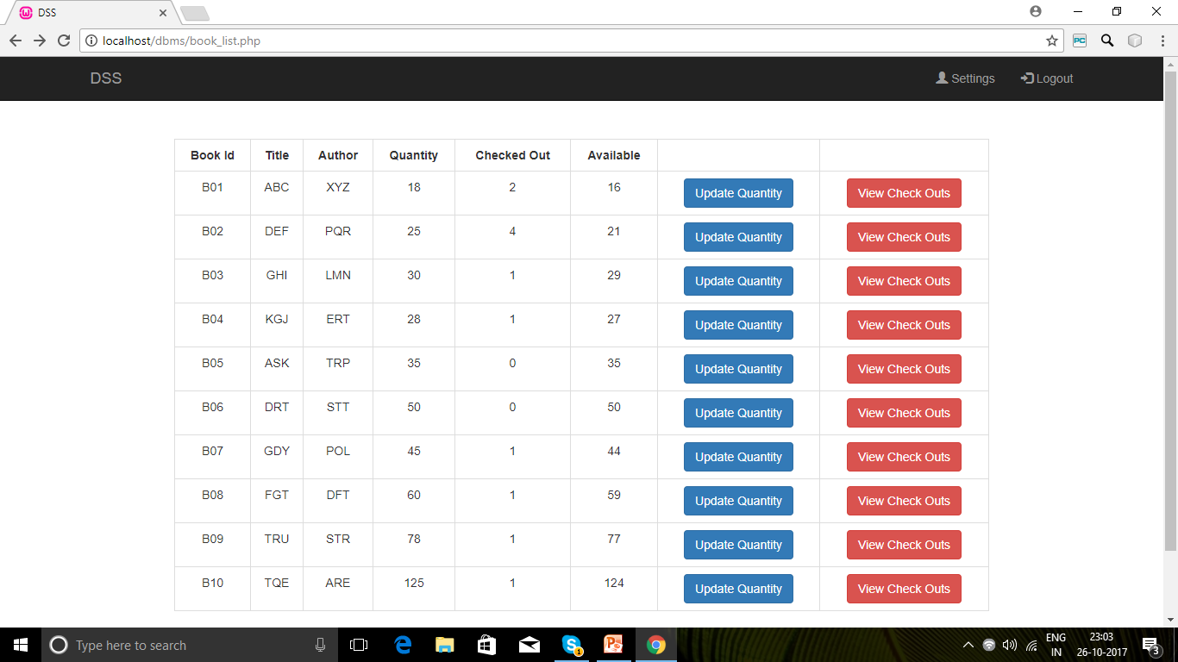
UPDATE EXISTING BOOK DETAILS
Allows a library staff to view the details of all books.
Records are retrieved from library_rec table.
A library staff can also update the quantity of a particular book and the same will be reflected in library_rec table.

Slide 30
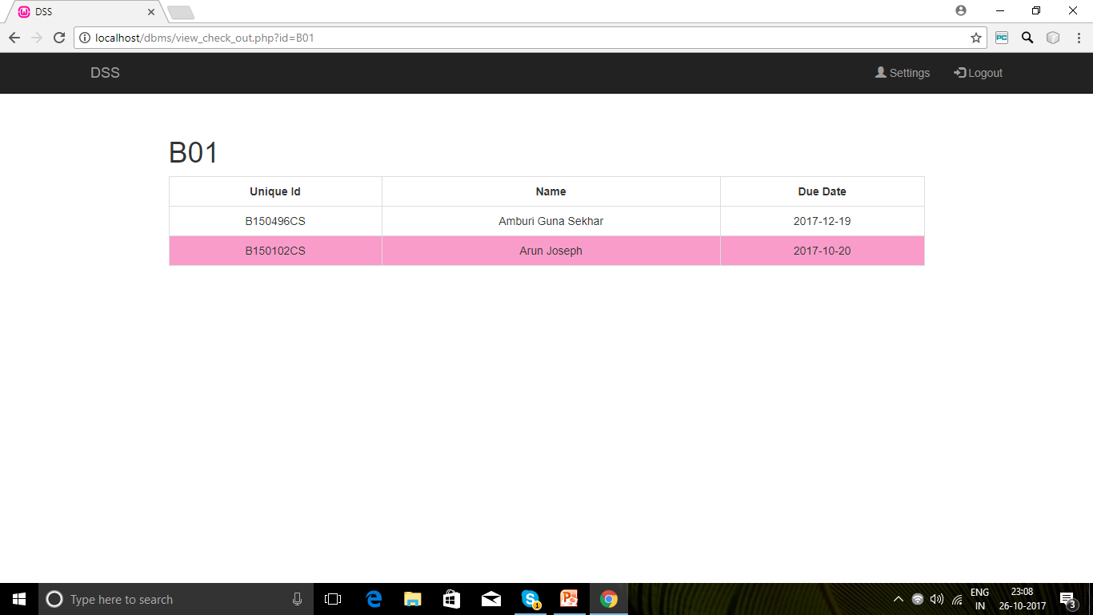
VIEW CHECK OUTS
Allows a library staff to view the borrowers of a particular book.
Records are retrieved from check_out table and library_rec table.

Slide 31
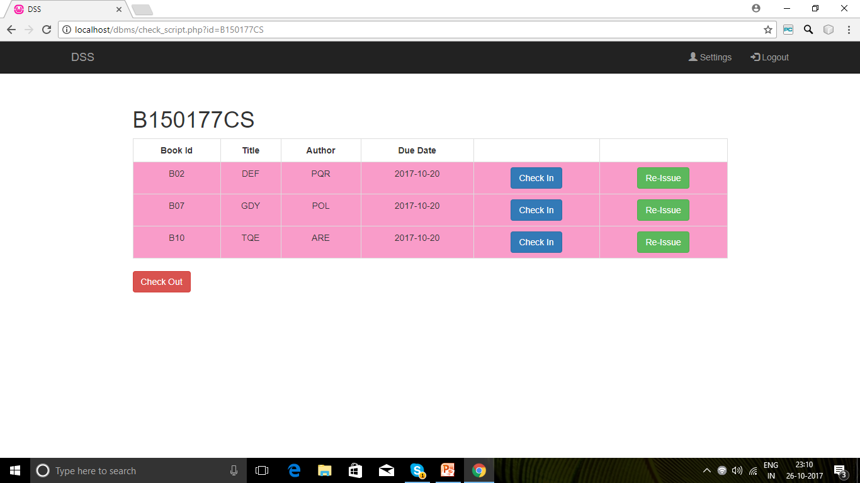
CHECK OUT/CHECK IN
Allows a library staff to check in, check out or re-issue a book.
The same is reflected in the check_out table.

Slide 32
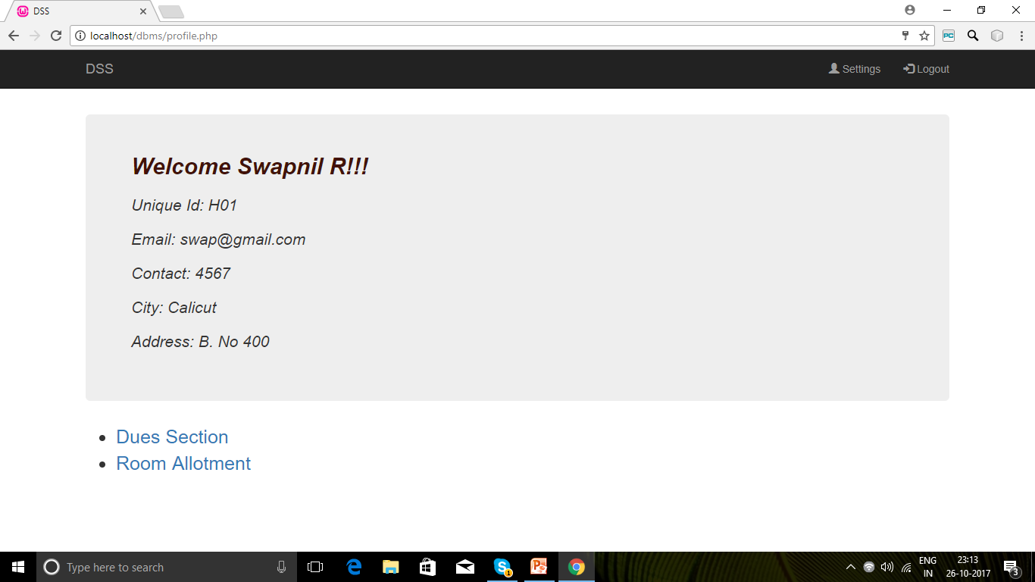
HOSTEL STAFF PAGE
Displays a menu of tasks which can be executed by a hostel staff.

Slide 33
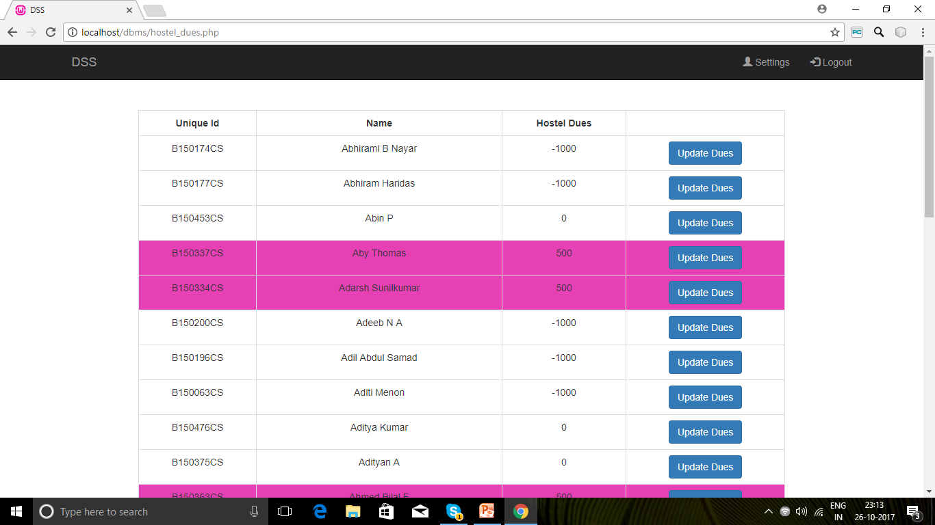
DUES SECTION
Allows a hostel staff to view the dues of all students.
Records are retrieved from users table.
A hostel staff can also update the dues of a student and the same will be reflected in the users table.

Slide 34
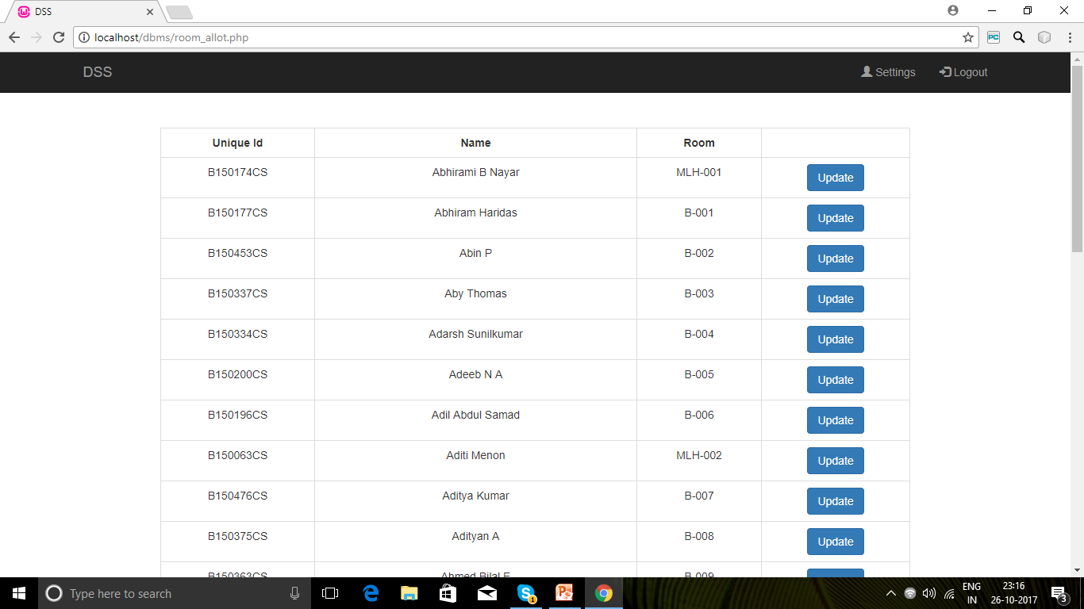
ROOM ALLOTMENT
Allows a hostel staff to view the rooms allotted for all students.
Records are retrieved from users table.
A hostel staff can also update the room allotted to a student and the same will be reflected in the users table.

Slide 35
THANK YOU

